Slide 1
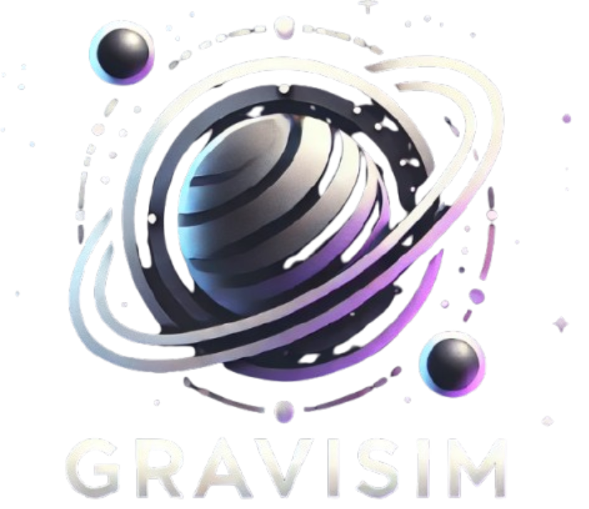
Gravisim Arnav maniar
Realistic Simulation of Planetary Orbits and Spacecraft Movement

Slide 2
Project Overview
Objective: Build a simulation that demonstrates gravitational interactions between a planet, its moon, and a spacecraft, with the ability to visualize orbits and real-time movement.
Key Features:
Visualizes the motion of planets, moons, and spacecraft.
Uses real-time physics to calculate orbital movement.
Interactive GUI with buttons to control the simulation.

Slide 3
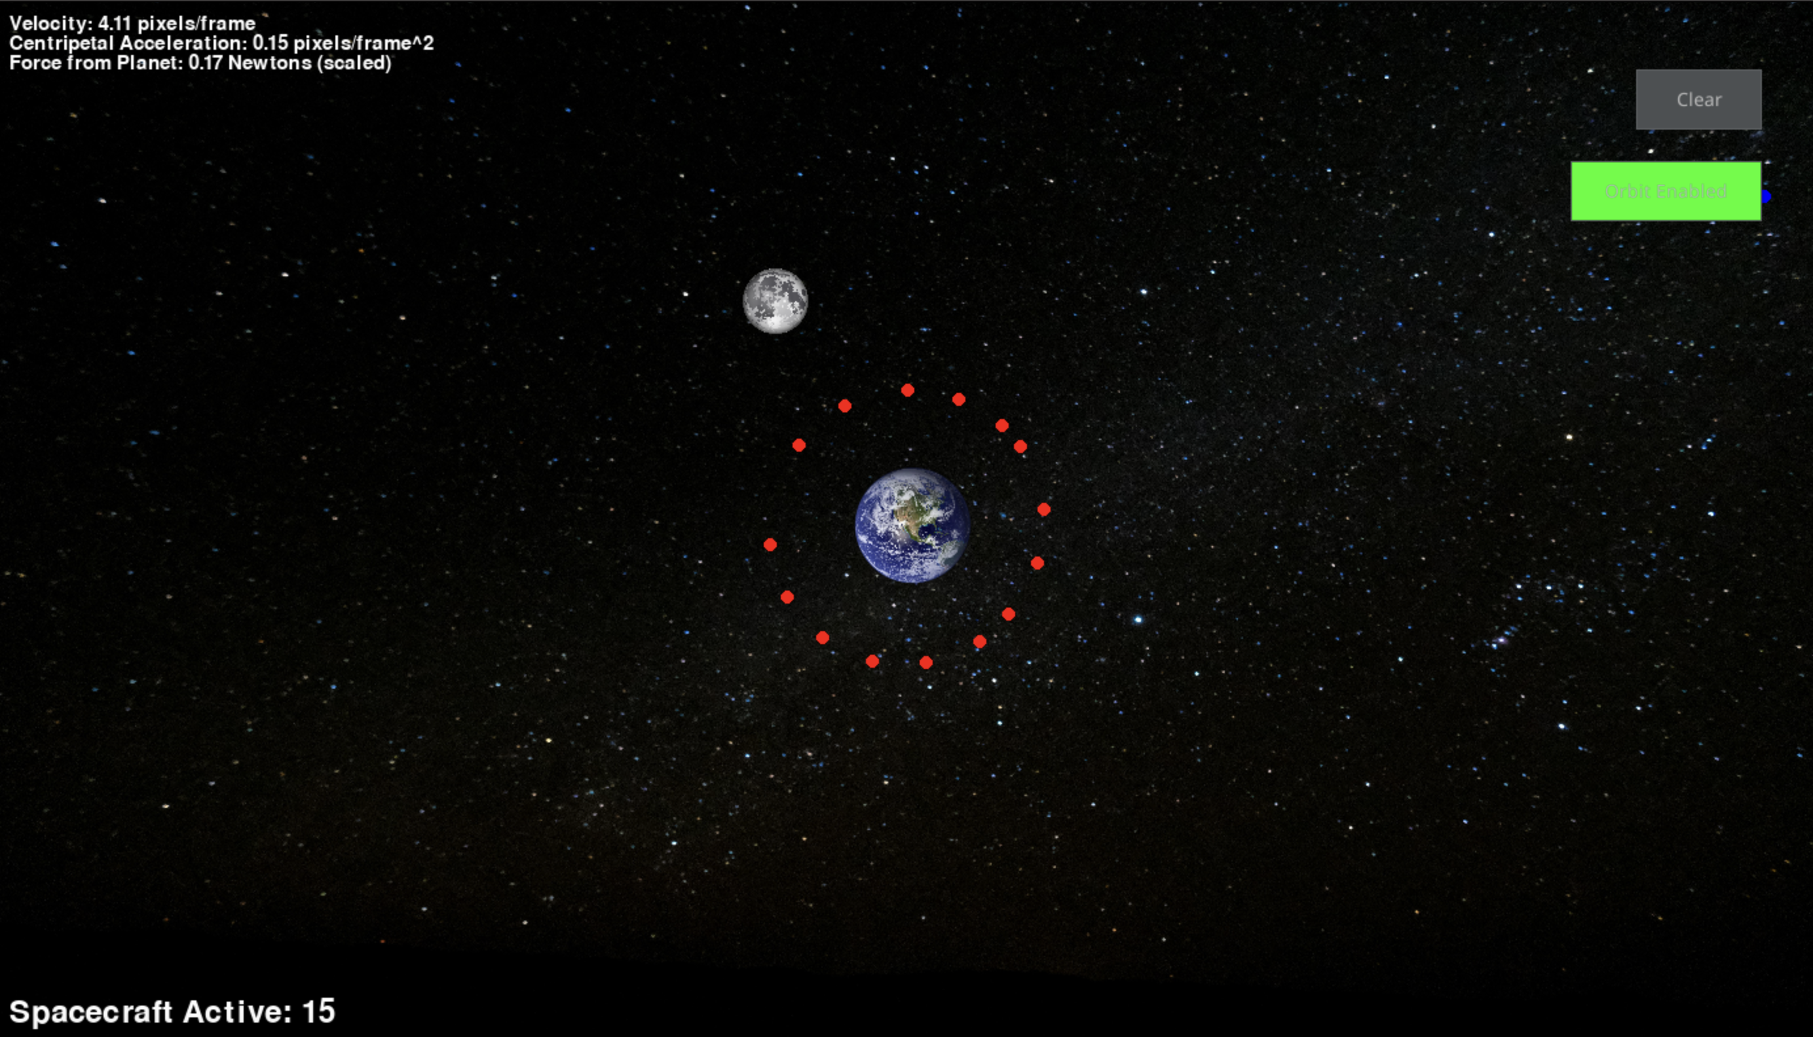
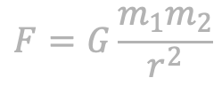
Core Concepts
Gravitational Forces:
Formula Used:
Objects are affected by gravitational attraction, calculated dynamically as they move.
Orbits and Movements:
Spacecraft can enter orbit around a planet once within a certain distance.
Movement is based on velocity, acceleration, and gravitational pull.
$$F=G\frac{m_{1}m_{2}}{r^{2}}$$

Slide 4
Simulation Features & Interactive Controls
Planet & Moon: The moon's position is updated in each frame based on its angular velocity.
Spacecraft Movement:
Spacecraft start at a given position with calculated velocity.
Can either enter orbit around the planet or be propelled by gravitational forces.
Auto Orbit Toggle & Controls: A button that enables or disables automatic orbital behavior for spacecraft.
Clear Button: Resets all spacecraft in the simulation.
Dynamic Info: Real-time data on velocity, acceleration, and gravitational force.

Slide 5
Educational Impact & Future Growth
Real-World Learning: By visualizing real-world phenomena in a controlled, interactive environment, students gain a deeper understanding of how space missions and satellite orbits are planned, which can inspire future careers in aerospace and other technology fields.
Future Growth: The simulation can be expanded to include more celestial bodies, spacecraft interactions, and advanced gravitational models, providing limitless opportunities for further educational exploration.

Slide 6
LIVE DEMO

